Slide 1


University name
Major Project/Internship– Paper Code
Project Report on
“Student Performance Analysis Report”
MCA (Master of Computer Applications)
Submitted To:
Submitted By:
Professor Name
Your Name
(Associate Professor)
Enroll Number

Slide 2
Content
Introduction
About The Company
About The Project
Objective
Dataset
Methodology
Tools And Techniques
System Diagrams
EDA Reports
PowerBI Dashboard
Business & Real-world Implications
Future Work
Result & Discussion
Conclusion

Slide 3
Introduction
Student Performance Analysis is an important process used to understand the academic behavior and achievements of students using data analytics techniques. This project focuses on analyzing a student dataset containing information such as GPA, attendance, study hours, parental support, extracurricular activities, tutoring, and demographic details. The main objective of the project is to identify patterns, trends, and factors that influence students academic performance.
The analysis is performed using Python libraries including Pandas, NumPy, Matplotlib, and Seaborn. Various data visualization techniques such as histograms, boxplots, scatterplots, heatmaps, and bar charts are used to represent the data effectively. Through Exploratory Data Analysis (EDA), meaningful insights are extracted to understand the relationship between attendance, study habits, parental support, and GPA.
This project helps educational institutions and students understand the key factors affecting academic success. It also demonstrates the practical implementation of data analytics and visualization techniques for educational data analysis and decision-making purposes.

Slide 4
About the Company
About the Company

Slide 5
About the Project
The Student Performance Analysis project is based on analyzing student academic data using data analytics and visualization techniques. The main objective of this project is to study various factors that influence students academic performance and identify meaningful patterns from the dataset.
The project uses a dataset containing information such as GPA, attendance, study hours, parental support, extracurricular activities, tutoring, age, gender, and grade class. By applying Exploratory Data Analysis (EDA), the project examines how these factors affect student performance and academic success.
Python programming language is used for implementing the project along with libraries such as Pandas, NumPy, Matplotlib, and Seaborn. Different types of visualizations including histograms, scatterplots, boxplots, heatmaps, and bar charts are created to represent the data clearly and generate useful insights.
The project helps in understanding student behavior, performance trends, and educational patterns. It also demonstrates practical applications of data analytics techniques in the education sector for better decision-making and performance improvement.

Slide 6
Project Objectives
The main objective of this project is to analyze student academic performance using data analytics and visualization techniques. The project aims to study the relationship between factors such as study hours, attendance, parental support, tutoring, extracurricular activities, and GPA. It also focuses on identifying trends and patterns that affect students academic success. By using Python libraries like Pandas, NumPy, Matplotlib, and Seaborn, the project performs Exploratory Data Analysis (EDA) to generate meaningful insights from the dataset. Various graphs and charts are used to visualize the data clearly and understand student behavior effectively. The project also aims to improve knowledge of data analysis techniques and demonstrate the practical application of data analytics in the education sector. Overall, the objective is to help understand the key factors influencing student performance and support better educational decision-making through data-driven analysis.

Slide 7
Dataset
Dataset Name: Student Performance Analysis Dataset Source: Kaggle (student academic performance dataset)
Contains student academic and personal information collected for performance analysis Provides detailed information about study behavior, attendance, GPA, and extracurricular activities Useful for analyzing academic trends and factors affecting student performance
Key Features of Dataset
Student ID and demographic information
Age and gender of students
Study hours and attendance records
GPA and grade class performance
Parental support and education details
Tutoring and extracurricular activity participation
Sports, music, and volunteering activities
Absence records and attendance percentage
Categorical and numerical educational data
Helps in identifying factors influencing academic success and student behavior

Slide 8
Methodology
The methodology used in this project involves several steps to analyze student academic performance effectively. First, the dataset was collected and imported into the Jupyter Notebook environment using Python. Libraries such as Pandas and NumPy were used for data cleaning, preprocessing, and handling missing or duplicate values.
After data cleaning, Exploratory Data Analysis (EDA) was performed to understand the structure and patterns within the dataset. Different statistical and visualization techniques were applied using Matplotlib and Seaborn libraries. Graphs such as histograms, boxplots, scatterplots, heatmaps, countplots, and bar charts were created to analyze relationships between variables like GPA, attendance, study hours, parental support, and extracurricular activities.
Feature analysis and grouping techniques were also used to compare academic performance across different categories. The results obtained from visualizations and statistical analysis were interpreted to generate meaningful insights about student behavior and academic trends. Finally, conclusions were drawn based on the analysis to understand the major factors affecting student performance.

Slide 9
Tools and Techniques
S.No | Tool / Library | Description
1. | NumPy | NumPy is a Python library used for numerical computing. It supports large multi-dimensional arrays and matrices, along with mathematical functions to perform fast and efficient operations on data.
2. | Pandas | Pandas is a powerful Python library used for data manipulation and analysis. It provides data structures like Series and DataFrame to handle structured data efficiently and perform cleaning, filtering, and transformation.
3. | Matplotlib | Matplotlib is a data visualization library in Python used to create graphs such as bar charts, line plots, histograms, and scatter plots for better understanding of data patterns.
4. | Seaborn | Seaborn is built on Matplotlib and is used for statistical data visualization. It helps in creating attractive and informative graphs like heatmaps, distribution plots, and categorical plots.
5. | Jupyter Notebook | Jupyter Notebook is an interactive environment used to write and execute Python code. It allows combining code, visualizations, and text in a single document for easy analysis and reporting.
6 | Power BI | Power BI is a business analytics and data visualization tool used to create interactive dashboards and reports. It helps in transforming raw data into meaningful insights using charts, graphs, KPIs, and filters for better decision-making and analysis.

Slide 10
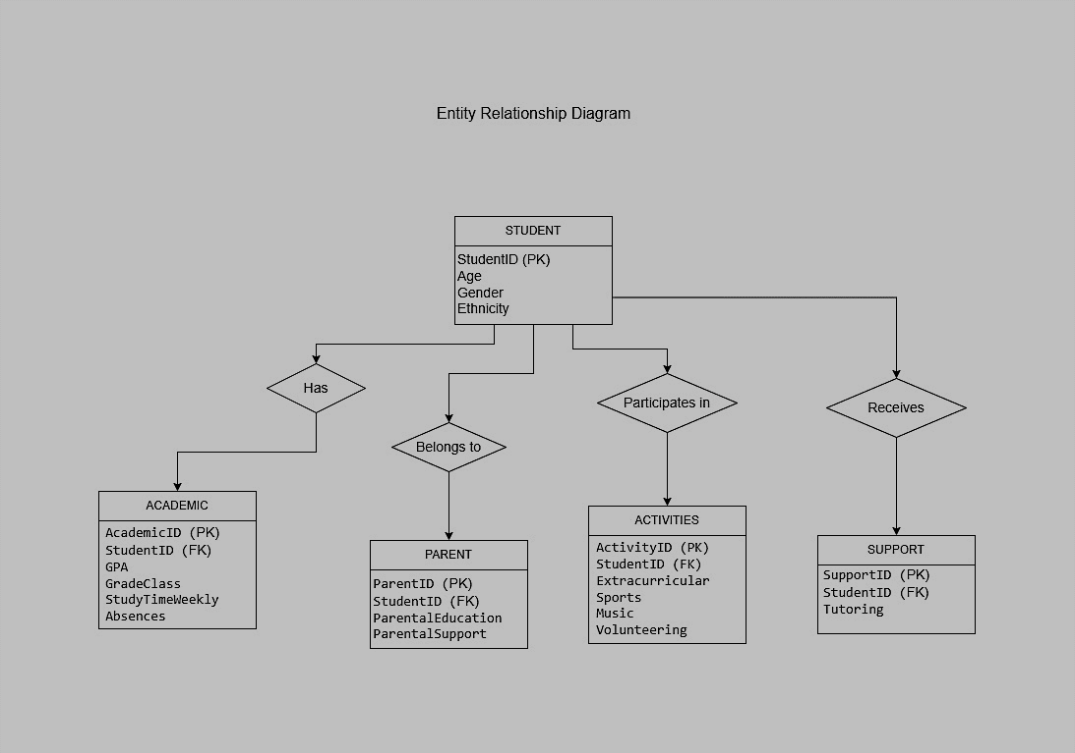
Entity RELATIONSIP Diagrams

Slide 11
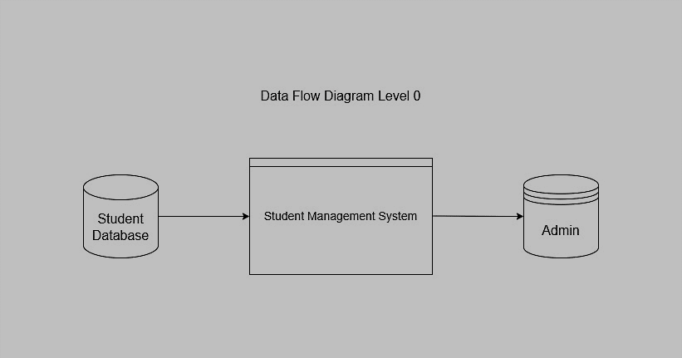
Data Flow Diagram

Slide 12
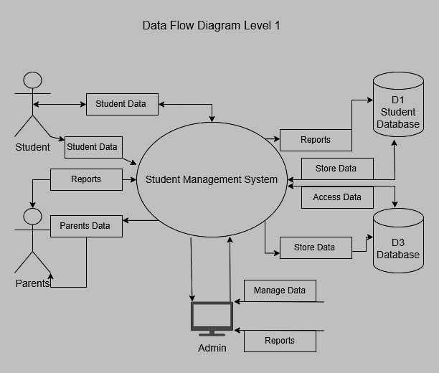
Data Flow Diagram

Slide 13
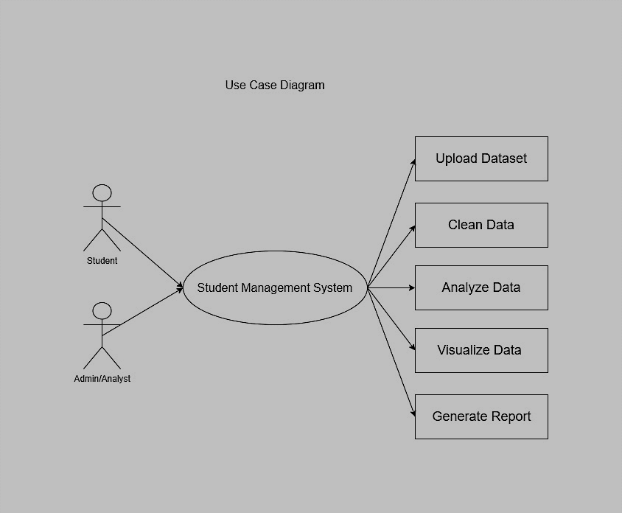
USE CASE DIAGRAM

Slide 14
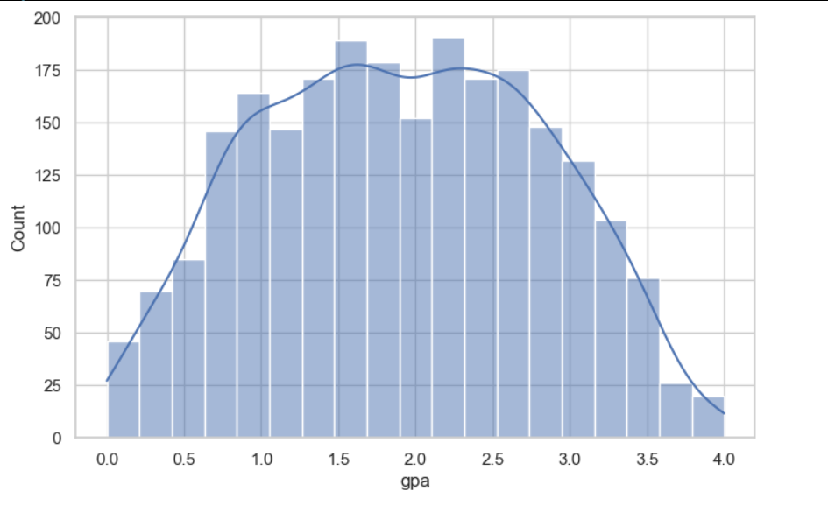
INSIGHTS:
1. Most Students GPA :
The histogram plot shows most students GPA values are concentrated around the average range overall.

Slide 15
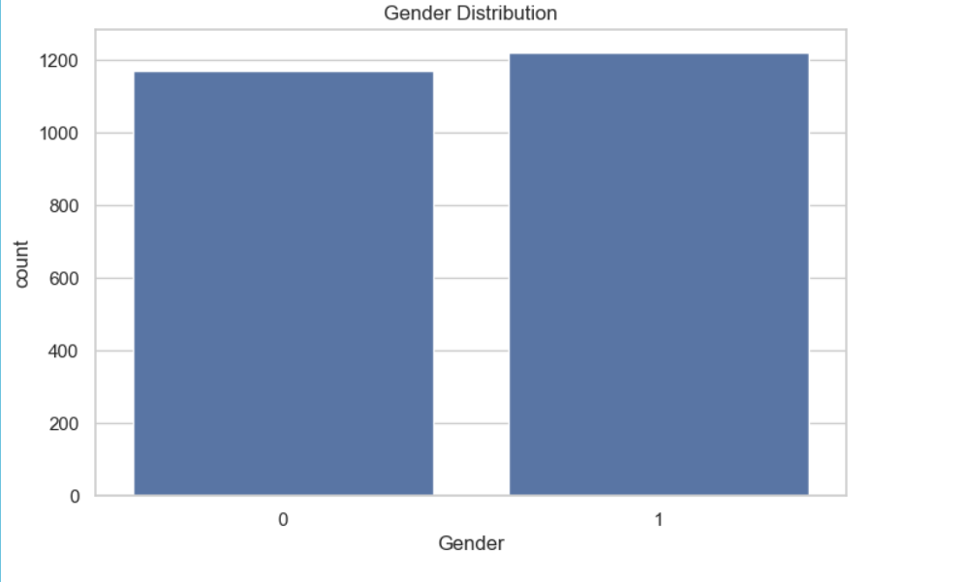
2. Gender Distribution
The countplot shows the distribution of male and female students in the dataset is nearly balanced

Slide 16
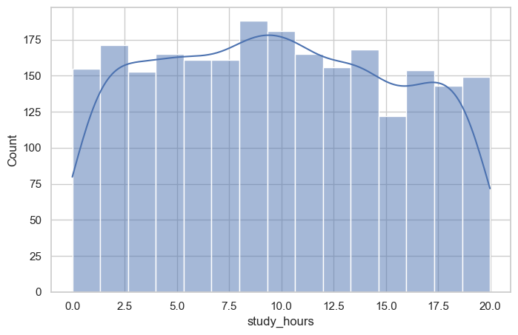
3. Study Hours Distribution
The histogram plot shows most students spend moderate weekly study hours with a smooth overall distribution.

Slide 17
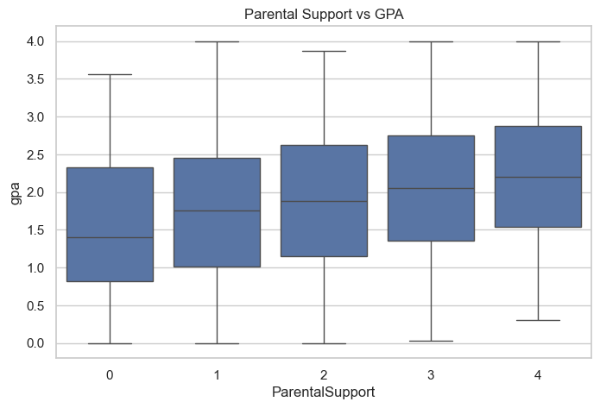
4. Parental Support By GPA Performance
The boxplot shows students with higher parental support generally achieve better GPA performance overall..

Slide 18
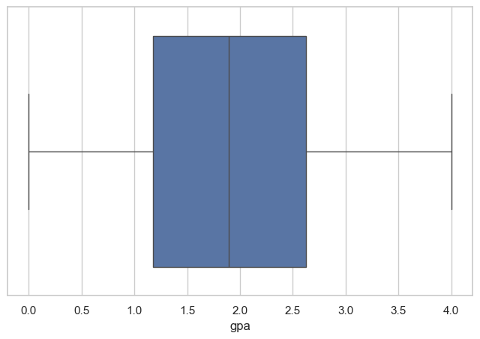
5. Student Academic Performance By GPA
The boxplot shows GPA values are moderately distributed with few outliers among student academic performance.

Slide 19
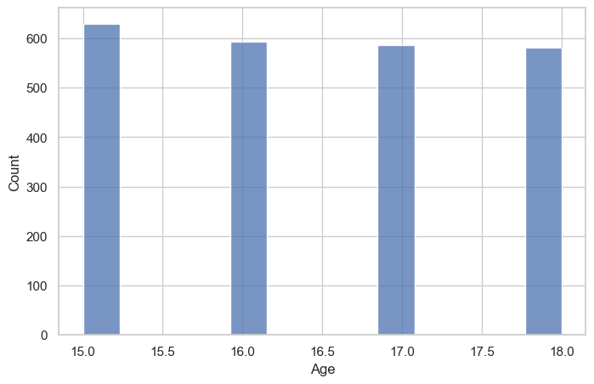
6. Age Distribution.
The histogram plot shows most students belong to a similar age group with balanced age distribution.

Slide 20
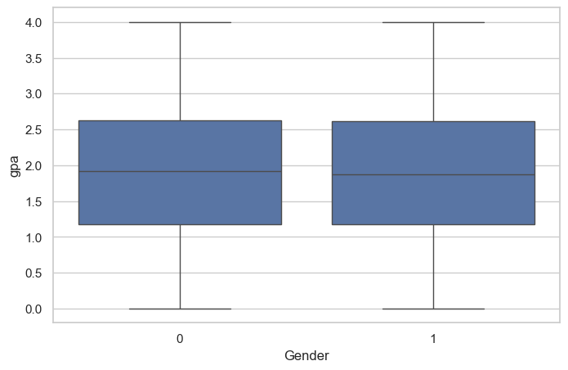
7. GPA distribution by Gender
The boxplot shows GPA distribution is nearly similar among male and female students overall.

Slide 21
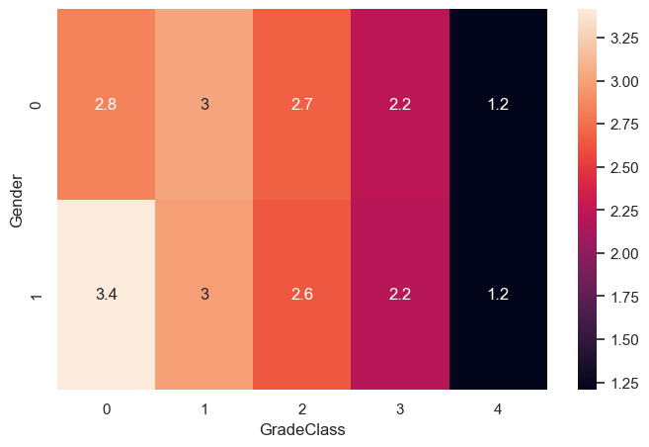
8. GPA Variation Between Gender And Grade Classes
The heatmap shows GPA variation across gender and grade classes with noticeable performance differences..

Slide 22
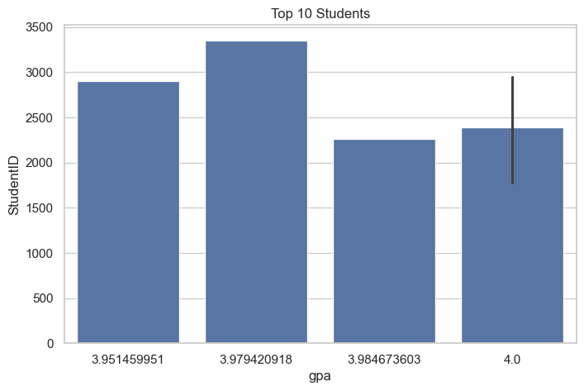
9. Top 10 Student Highest Score
The barplot displays the top 10 students with highest GPA scores in the dataset.

Slide 23
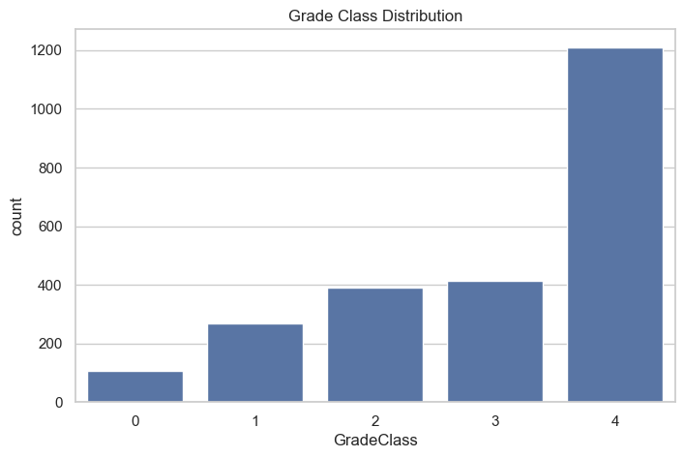
10. Grade Classes Distribution
The countplot shows the distribution of students across different grade classes in the dataset.

Slide 24
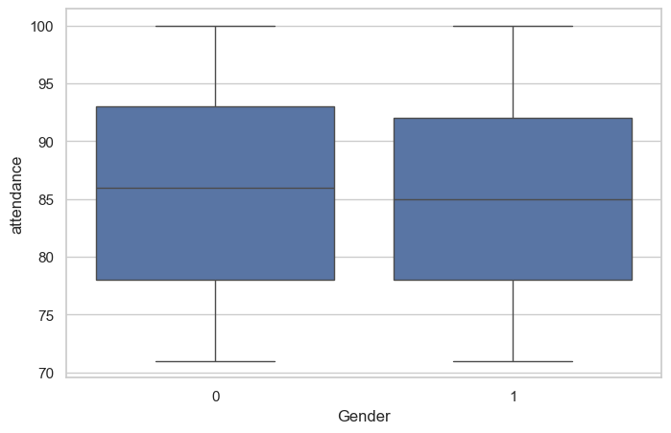
11. Attendance Distribution By Gender
The boxplot shows attendance distribution is nearly similar among male and female students overall.

Slide 25
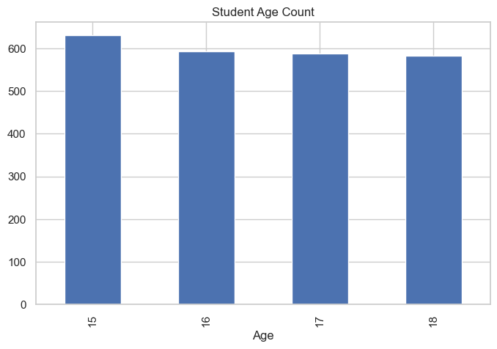
12. Student Age Count By Age
The bar graph shows most students belong to limited age groups with similar population distribution.

Slide 26
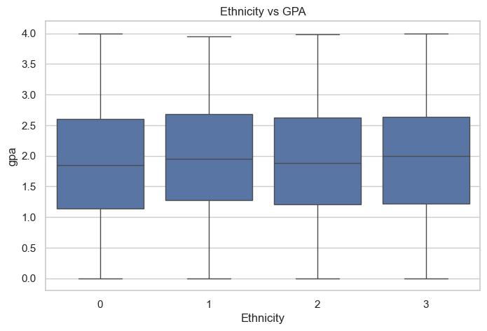
13. GPA by Ethnicity
The boxplot shows GPA performance varies slightly across different ethnic groups in the student dataset.

Slide 27
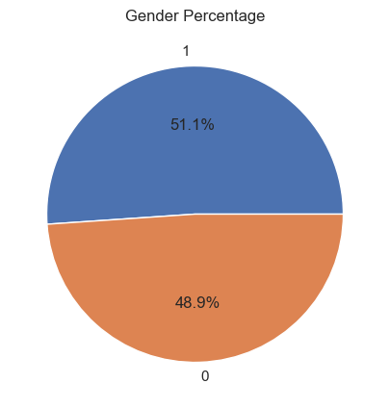
14. Gender Percentage
The pie chart shows male and female student percentages are nearly balanced in the dataset overall.

Slide 28
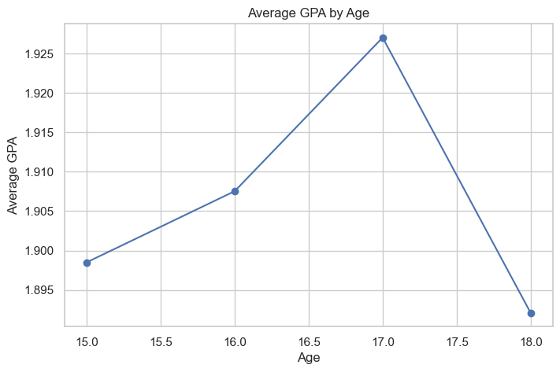
15. Average GPA By Age
The line plot shows average GPA changes slightly across different student age groups overall.

Slide 29
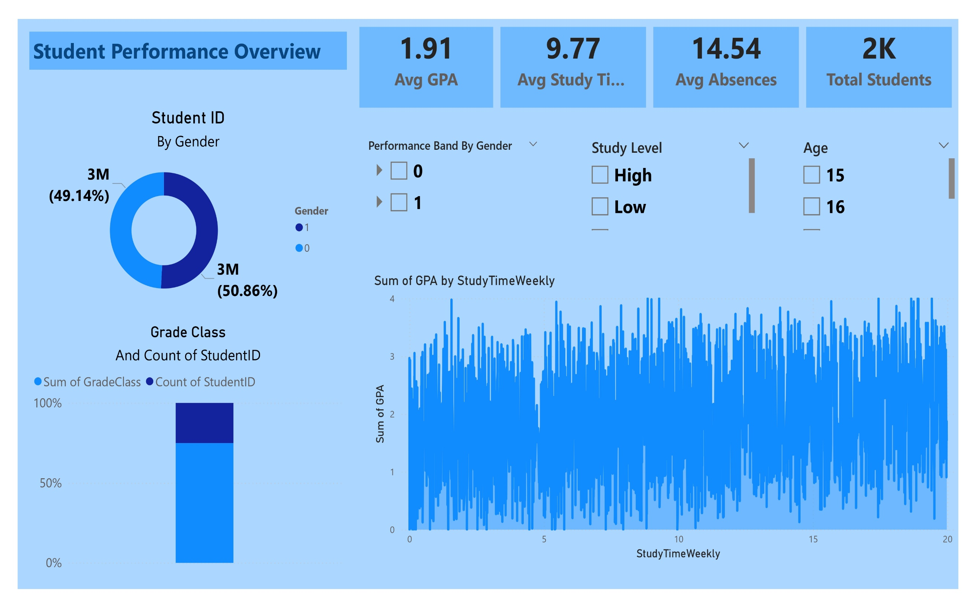
Power Bi Dashboard

Slide 30
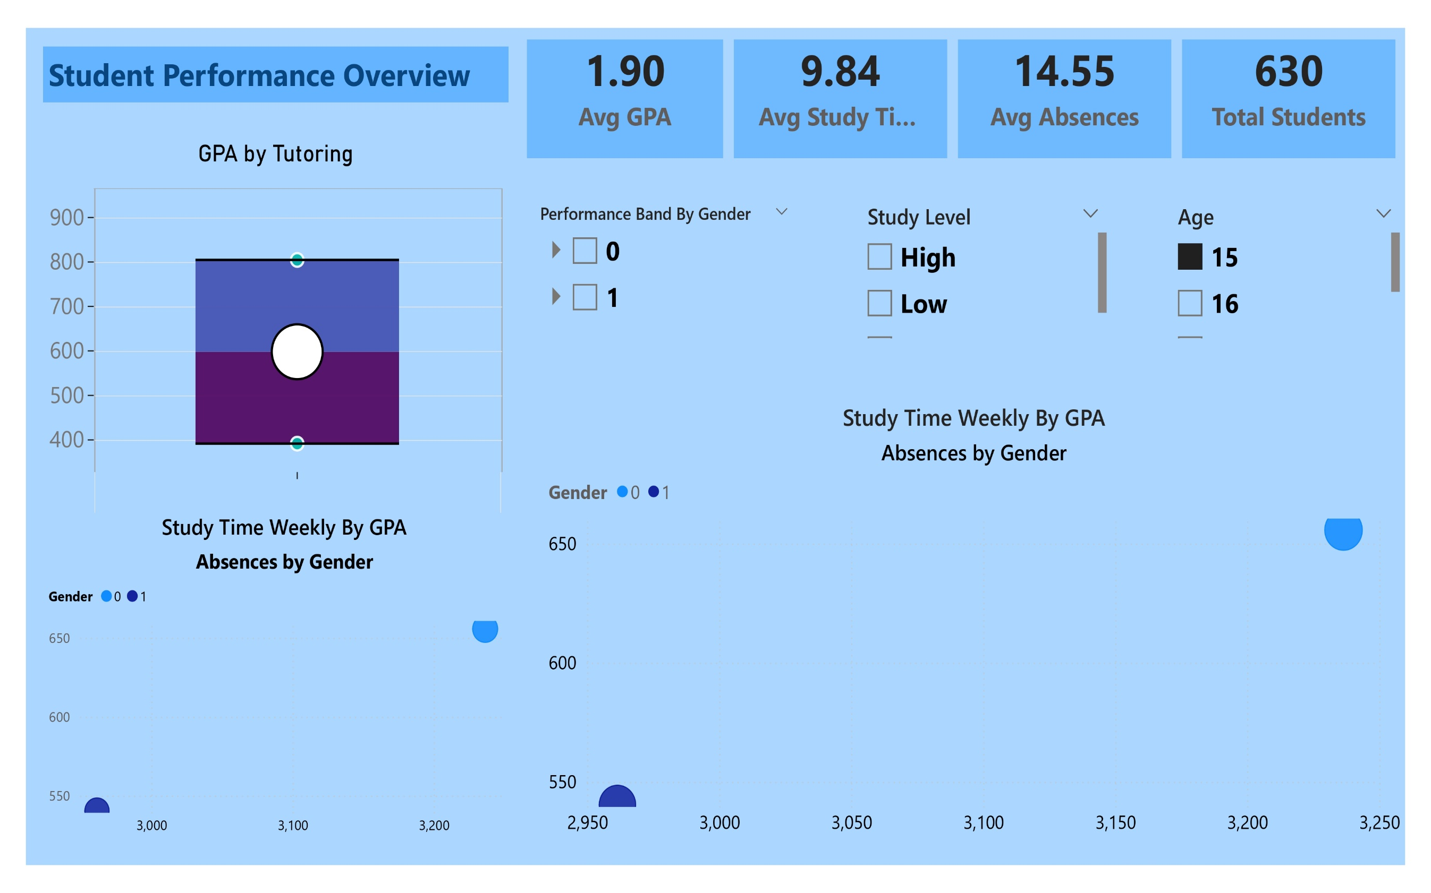
Power Bi Dashboard

Slide 31
Business & Real-World Implications
The Student Performance Analysis project has significant real-world and educational implications. By analyzing factors such as study hours, attendance, parental support, tutoring, and extracurricular activities, the project helps educational institutions understand the major elements affecting student academic performance. The insights generated from the analysis can assist schools and colleges in improving teaching strategies, student engagement, and academic planning.
Educational organizations can use the findings to identify students who may require additional academic support or counseling. Attendance and GPA analysis can help institutions reduce dropout rates and improve overall student outcomes. The project also supports data-driven decision-making by enabling educators to monitor performance trends and create personalized learning approaches.
From a business perspective, educational technology companies and training organizations can use such analysis to develop better learning platforms and student performance monitoring systems. The project demonstrates how data analytics and visualization techniques can be applied in the education sector to improve efficiency, academic success, and institutional performance through informed decision-making.

Slide 32
Future Work
The future scope of this project includes applying advanced data analytics and machine learning techniques to improve the accuracy and depth of student performance analysis. Predictive models can be developed to forecast student academic outcomes based on factors such as attendance, study hours, parental support, and extracurricular activities. Additional datasets from schools and colleges can also be integrated to perform large-scale educational analysis and generate more accurate insights.
Future improvements may include the development of interactive dashboards using Power BI or Tableau for real-time data visualization and monitoring. The project can also be enhanced by implementing classification and recommendation systems to identify at-risk students and suggest personalized improvement strategies.
Further analysis can be performed using deep learning and artificial intelligence techniques to automate performance prediction and academic trend analysis. This project can also be extended for use in educational institutions to support data-driven decision-making, improve academic planning, and enhance overall student performance management systems.

Slide 33
Result & Discussion
The analysis of the student performance dataset generated several meaningful insights regarding academic behavior and performance trends. The results showed that students with higher study hours and better attendance generally achieved higher GPA scores. It was also observed that parental support and tutoring positively influenced students’ academic performance.
Different visualizations such as histograms, boxplots, scatterplots, heatmaps, and bar charts were used to understand relationships between variables. The GPA distribution analysis indicated that most students performed within an average academic range. Attendance analysis showed that students with fewer absences usually had better academic results.
The project also revealed that extracurricular activities, sports participation, and volunteering had a moderate positive impact on student performance. Gender-based analysis showed relatively balanced academic performance among male and female students.
Overall, the project successfully demonstrated the use of data analytics and visualization techniques in educational data analysis. The findings can help educational institutions identify important academic factors and improve decision-making for enhancing student performance and learning outcomes.

Slide 34
Conclusion
The Student Performance Analysis project successfully analyzed various academic and personal factors affecting students’ performance using data analytics and visualization techniques. The project demonstrated how factors such as study hours, attendance, parental support, tutoring, and extracurricular activities influence students’ GPA and overall academic achievement.
Using Python libraries like Pandas, NumPy, Matplotlib, and Seaborn, the dataset was cleaned, processed, and visualized effectively through different graphs and statistical analysis methods. The analysis revealed that students with better attendance, higher study hours, and stronger parental support generally performed better academically.
The project also highlighted the importance of Exploratory Data Analysis (EDA) in identifying trends, patterns, and relationships within educational data. The generated insights can help educational institutions improve student performance, academic planning, and decision-making processes.
Overall, this project provided practical experience in data analysis, visualization, and interpretation while demonstrating the real-world application of data analytics in the education sector.

Slide 35
Thank You

